Slide 1
Capstone Project Finance and Risk Analysis
Prepared By: Balwinder Sharma, Shraddha Shukla and Sejal Sahu

Slide 2

Agenda
Problem statement
Objective
Approach statement
Data Analysis and insight
Visualization
Portfolio Analysis

Slide 3
Problem Statement
We have portfolio of two investors with different risk appetites. One customer is conservative in nature and looking for investment in shares where risk is low and invested funds should double in 5 years and second investor is interested in high risk returns. We will be suggesting the shares as per their risk appetite by doing analysis of given dataset for this project.
The two investors are Mr Patrick Jyenger and Mr Peter Jyenger .

Slide 4
Objective
According to the given problem statement our task is to create portfolio for the customer as per below details for each investor
Investor 1 : Mr Patrick Jyenger wants to invest $500K in equities, he has been conservative investor during his all life and expects doubling his capital with less risk in 5 years time.
Investor 2 : Mr Peter Jyenger wants to invest $1 million in equities, he has been high risk investor during his all life, prefers high return investment and expects doubling his capital with high risk in 5 years time.

Slide 5
Approach Statement
1. Exploratory Data Analysis
2. Data Analysis for Portfolio Making
3. Insight and Conclutions
Checking the data set for null values and any other noise in given data.
Verification of data with respect to outliers to avoid any error in analysis due to outlier values
FB stock was listed later so we have assigned the figure “0” where data not available
Data analysis has been dine with the help of python using various libraries Such as pandas , numpy, plotly .
Visualization is done using power BI for sector wise and trend analysis purpose.
Calculations were done for daily returns, Cumulative returns , sharp ratios and selected best stocks as per Risk appetite
Insights drawn from careful data analysis and selected stocks as per risk appetite of investors.
Sector wise analysis has given us insight regarding performance of various sector wise stocks and technology stocks have outperformed in returns.
On the basis of insight drawn we have finalized the portfolio for investors

Slide 6
Details of Data Provided for Analysis
Ticker | Industry | Company Name
AAL | Aviation | American Airlines Group Inc
ALGT | Aviation | Allegiant Travel Company
ALK | Aviation | Alaska Air Group Inc
DAL | Aviation | Delta Air Lines Inc
HA | Aviation | Hawaiian Holdings Inc
LUV | Aviation | Southwest Airlines Co
BCS | Finance | Barclays
CS | Finance | Credit Suisse
DB | Finance | Deutsche Bank
GS | Finance | Goldman Sachs
MS | Finance | Morgan Stanley
WFC | Finance | Wells Fargo
JNJ | Healthcare | Johnson & Johnson
MRK | Healthcare | Merck and CO inc.
PFE | Healthcare | Pfizer inc
UNH | Healthcare | UnitedHealthGroup Inc
BHC | Pharmaceuticals | Bausch Health Companies inc
RHHBY | Pharmaceuticals | Roche Holding AG
AAPL | Technology | Apple Inc
AMZN | Technology | Amazon
FB | Technology | Facebook
GOOG | Technology | Alphabet
IBM | Technology | IBM
MSFT | Technology | Microsoft
There are 24 stocks available from four sectors containing 6 stocks from each sector.
There is an index available to compare the stocks outcome with. S&P500 is a combinations of top 500 stocks in US stock market.
Details of each stock provided for reference which is used for analysis and portfolio building.

Slide 7
Sector Wise Analysis of Stocks with Normalized Values
Data is provided for 4 sectors for analysis purpose as per details provided as below detailed insight and visualization shared in subsequent slides.
Aviation sector
Financial sector
Health and pharma sector
Technology sector

Slide 8
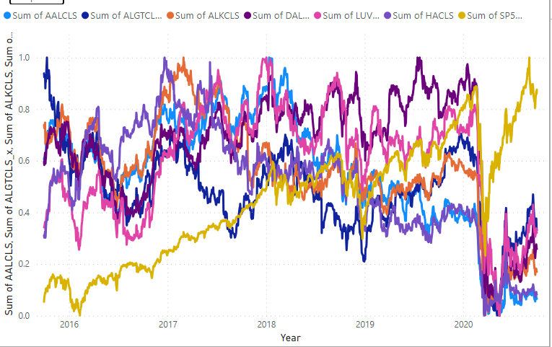
Aviation Sector Stocks Analysis & Insight
S&P500 is not co-related to Aviation Sector.
Market took a massive hit in 2020 due to corona pandemic which resulted in a bear market.
Even though the market recovered but the Aviation Sector underperformed the market.
All the stocks are underperformed as compared to S&P 500 index and tagged as high risk stocks

Slide 9
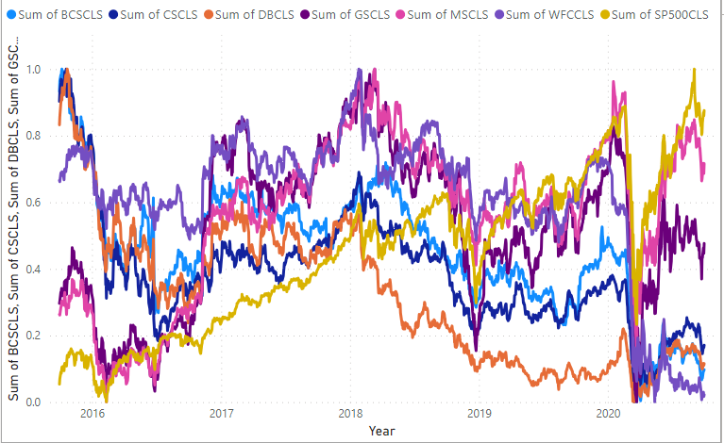
Finance Sector Stocks Analysis & Insight
S&P500 is not co-related to Financial Sector.
Market took a massive hit in 2020 due to corona pandemic which resulted in a bear market.
Financial sector had given mixed response as compared to market index. Morgan Stanley and Goldman Sachs have given good returns
All the stocks other financial sector underperformed as compared to S&P 500 index and tagged as high risk stocks

Slide 10
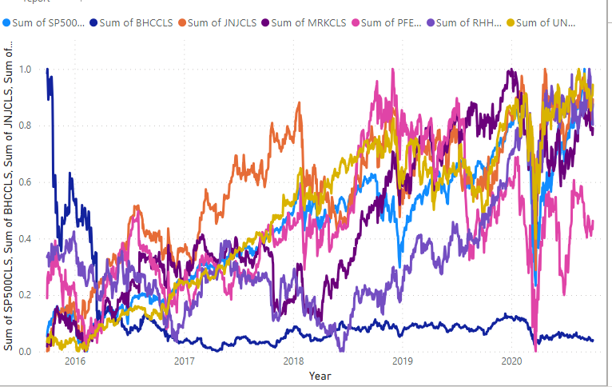
Health and Pharma Sector Stocks Analysis & Insight
S&P500 is positively co-related with Health and Pharma Sector(JNJ, MRK, UNH).
During the pandemic health and pharma and technology sector showed rapid growth after the market crash in comparison to other industries.
From past 5 years we can see that Bausch Health Companies inc has not seen any growth.
Overall the health and pharma sector is strong compared to S&P500.

Slide 11
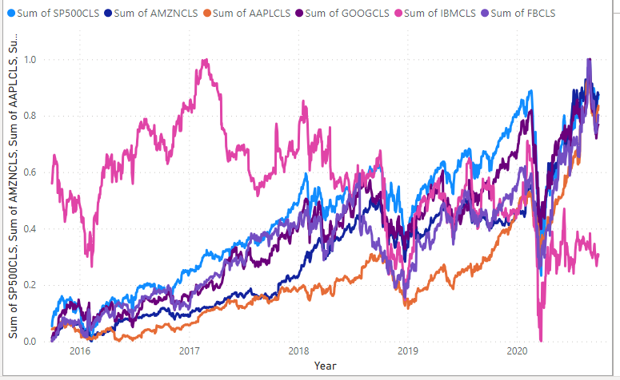
Technology Sector Stocks Analysis & Insight
S&P500 is strongly co-related to Technology Sector.(AMZN,GOOG)
When compared to other sectors during the pandemic Tech sector was one of few sectors to bounce back sharply.
Except for IBM all the other stocks are out performing the market.
Also all the stocks except for IBM are strongly co-related with each other.

Slide 12
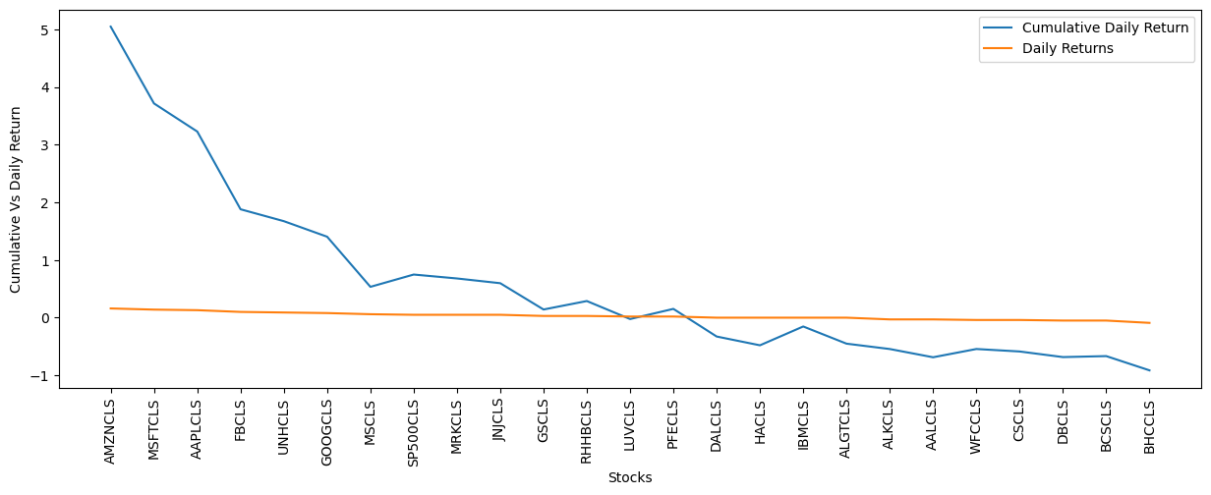
Top Stocks on the Basis of Annualized Returns & Comparison Cumulative Returns & Daily Returns
At the end of 5 years we can see that the top 8 performing stocks based on Annual Returns:
AMZN gives 40.59% annual returns
MSFT gives 34.95% annual returns
AAPL gives 33.32% annual returns
FB gives 26.45% annual returns
UNH gives 23.72% annual returns
GOOG gives 21.02% annual returns
MS gives 14.55% annual returns
MRK gives 12.88% annual returns

Slide 13
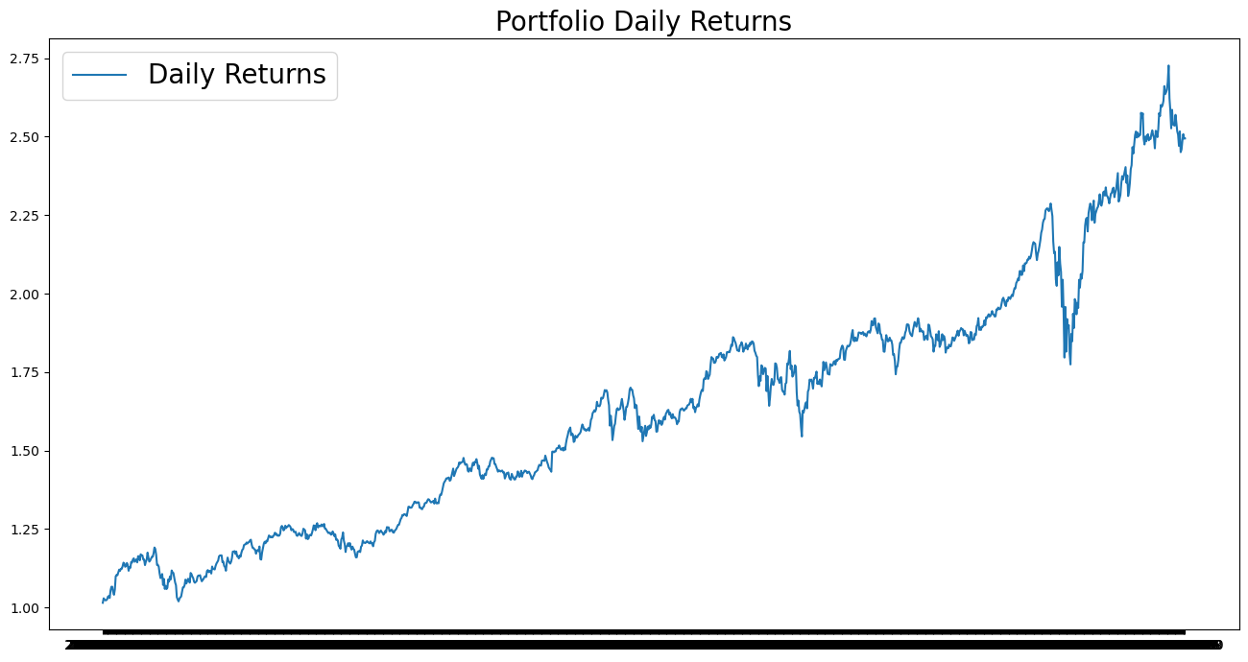
Mr. Patrick Jyengar Portfolio Analysis
Mr. Patrick want to invest in low risk stocks and investment amount is 500 thousand which should yield decent returns
Equal weightage given to each stock investment at the time of investing in stocks.
Amazon , Johnson and Johnson, Roche Holding and google stocks are selected as part of his portfolio.
Mr. Patrick’s total earning will be 1.24 from investment of 500000 dollars and earning will be 7.24 from invested amount.

Slide 14
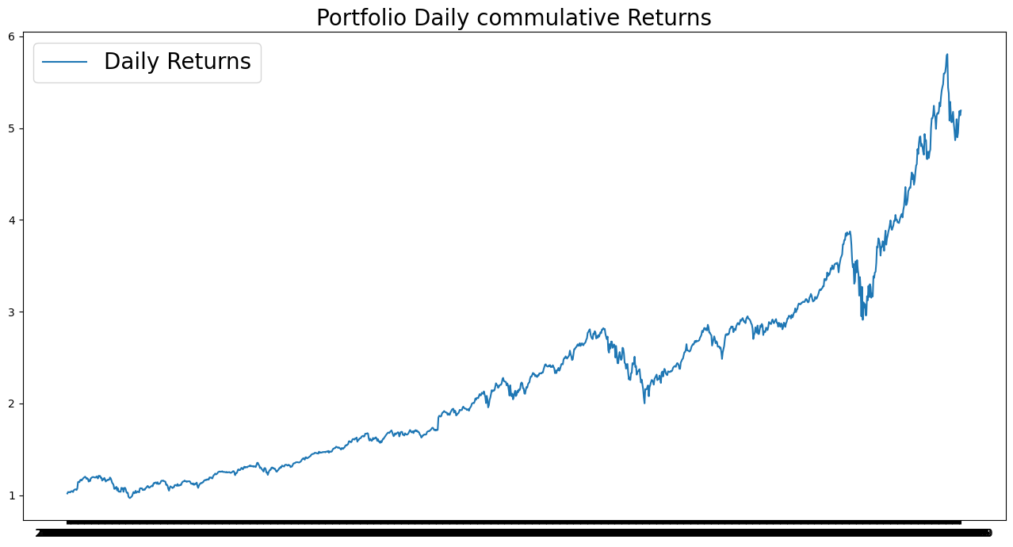
Mr. Peter Jyengar Portfolio Analysis
Mr. Peter Jyengar on the other hand Consistent with his attitude towards risk, he prefers high-return investments. Believes that he can still bounce back in case of any occasional losses.
He Wants to invest 1 million dollar from company's cash and cash equivalents in the most high-margin stocks which expects high returns within 5 years for inorganic expansion of his company.
As per his profile High risk/High Returns stocks like AMZN, MSFT and AAPL is suitable to invest on.
As Mr. Peter Jyengar invests 1 Million Dollars in equities. The returns that he would get after 5 years of time period is more than 5 Million Dollars with more than 4 Million Dollars of gain.

Slide 15
Thank You

